Slide 1
Gift Box An Exploration of Augmented Reality
Student: Siyan Ding
Professor: Kenny Hunt

Slide 2
Contents
Introduction
Requirements
Design
Implementation
Challenges
Future Work and Conclusion

Slide 3
Introduction

Slide 4
Introduction
This capstone project developed an Android application and a web interface. The requirements gathering, design, implementation and testing phases are outlined. The Android application will allow users to attach virtual objects, or gifts, at specific locations in the real world. Virtual entities will be viewable and recoverable only by those individuals that the user selects. Recipients can only see the gifts when scanning the exact scene from which the virtual message was sent. The web interface will allow users to view their personal data and have an overview of the application before they download the Android application.

Slide 5
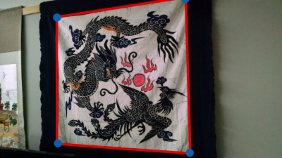
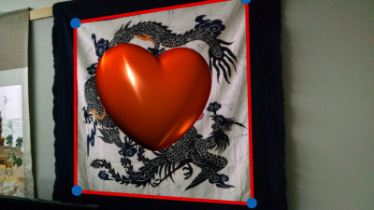
Introduction

Slide 6
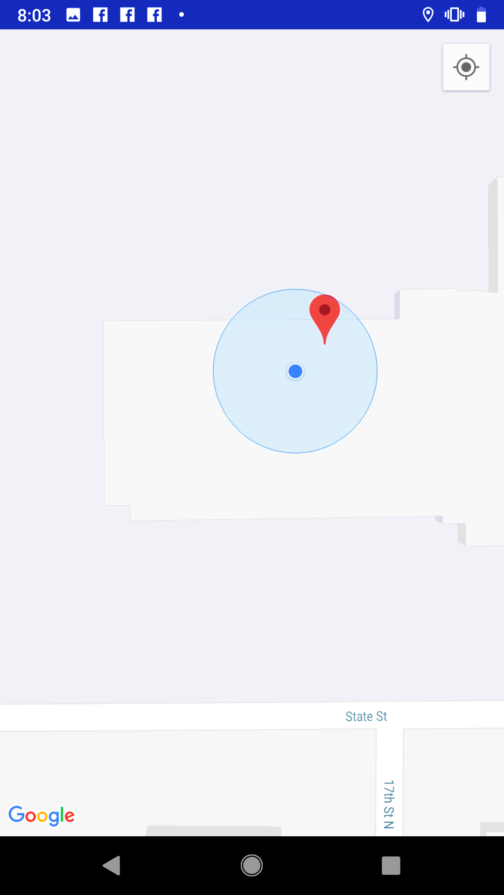
Introduction

Slide 7
requirements

Slide 8
Functional requirements
The ‘Log In’ function allows users to log in to the system
The ‘Log Out’ function allows users to log out of the system
The ‘Add Friends’ function allows users to add other users as friends. This add function doesn't need other users' agreement
The ‘Search Friends’ function allows users to search other users by username

Slide 9
Functional requirements
The ‘Delete Friends’ function allows users to delete friends from their friends list
The ‘Edit Profile’ function allows users to edit their password and portrait information. The username and email cannot be changed after registration
The ‘View Gifts’ function allows users to view their gifts. Gifts are filtered based on Sent or Received
The ‘Send Gifts’ function allows users to send virtual gifts to other users

Slide 10
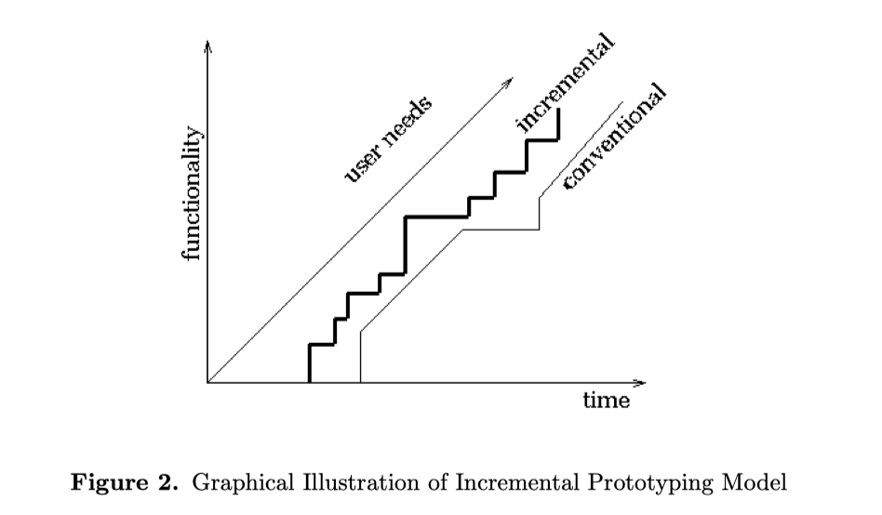
Life Cycle Model
Consistency between requirements is checked in each iteration
Developers ensure that the product is partially ready with selected requirements
Customers provide feedback with each increment

Slide 11
Design

Slide 12
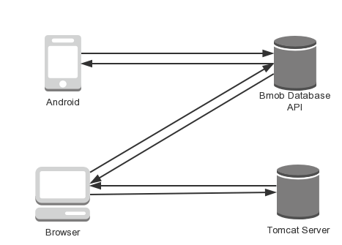
System structure

Slide 13
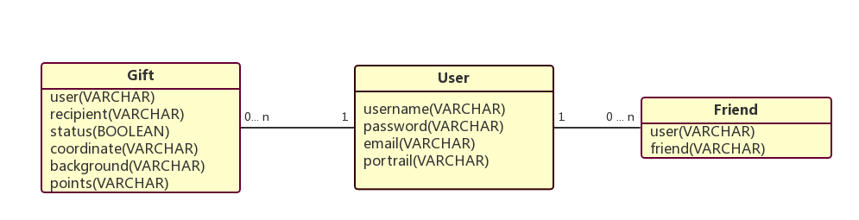
Database Design
The entity relationship (ER) diagram for the whole project

Slide 14
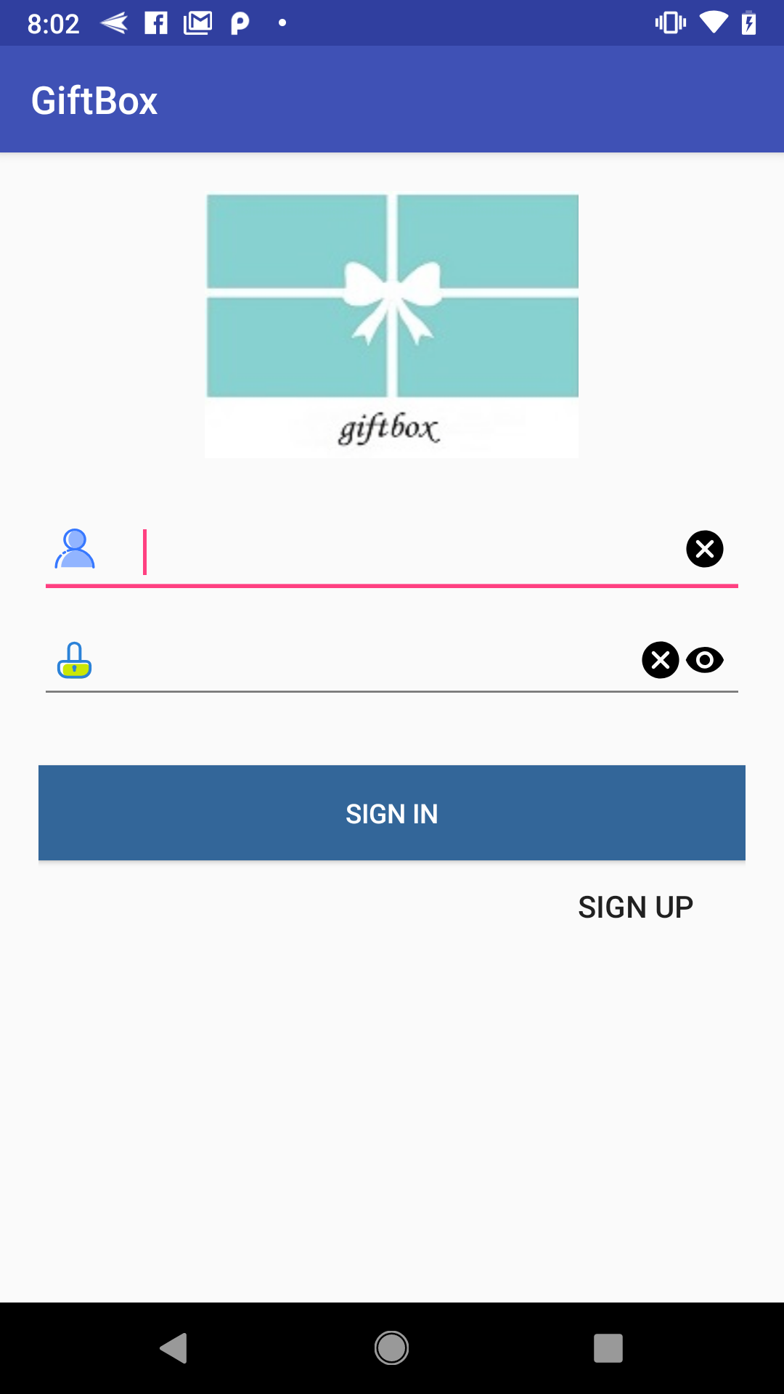
UI Design
Sign In Page

Slide 15
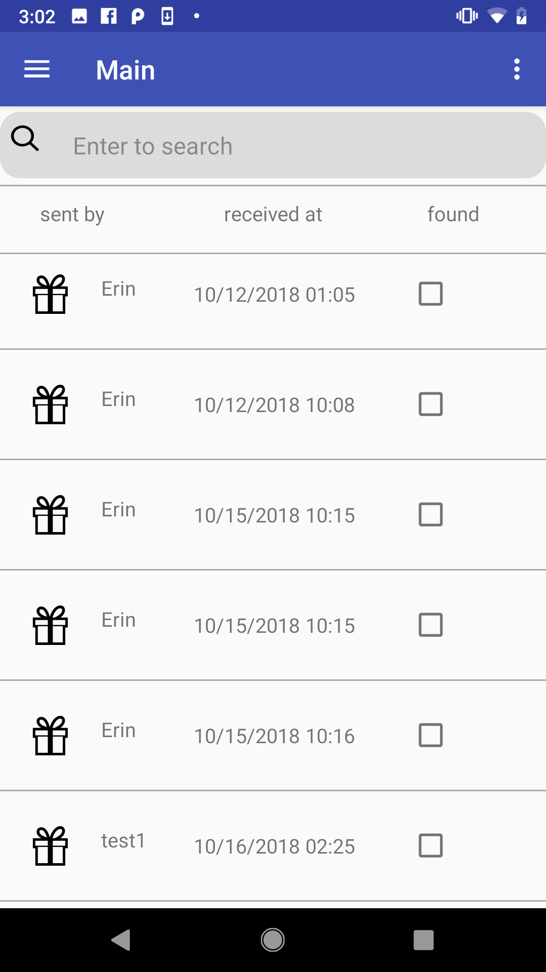
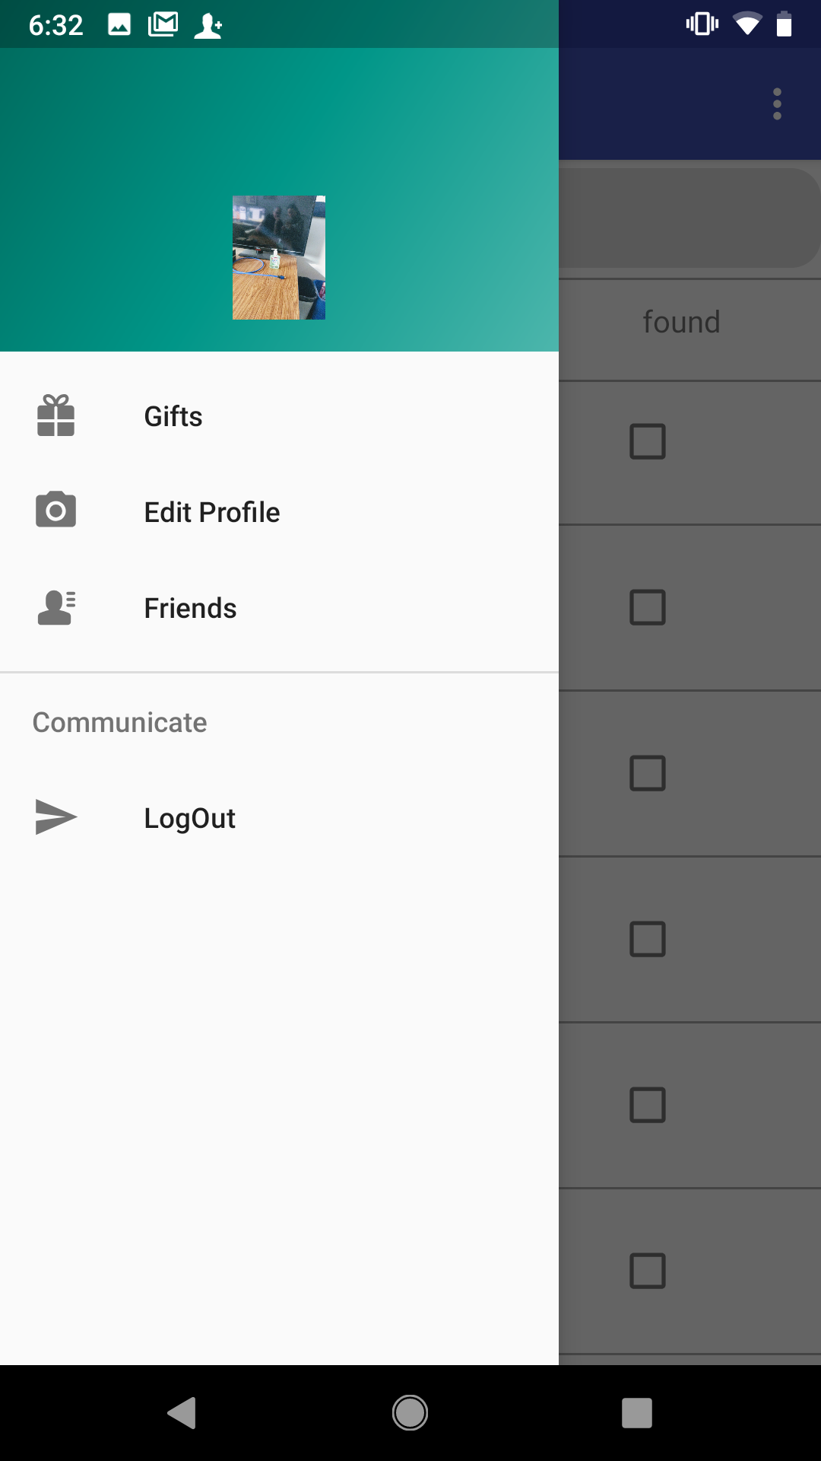
UI Design
Main Page

Slide 16
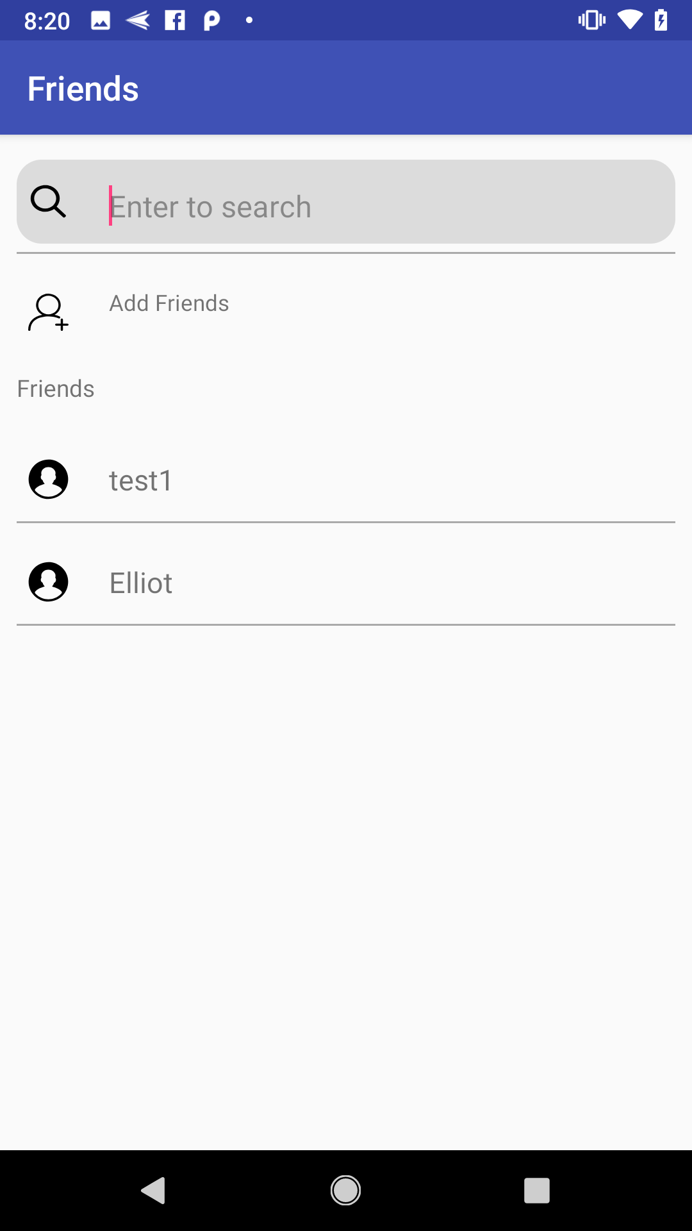
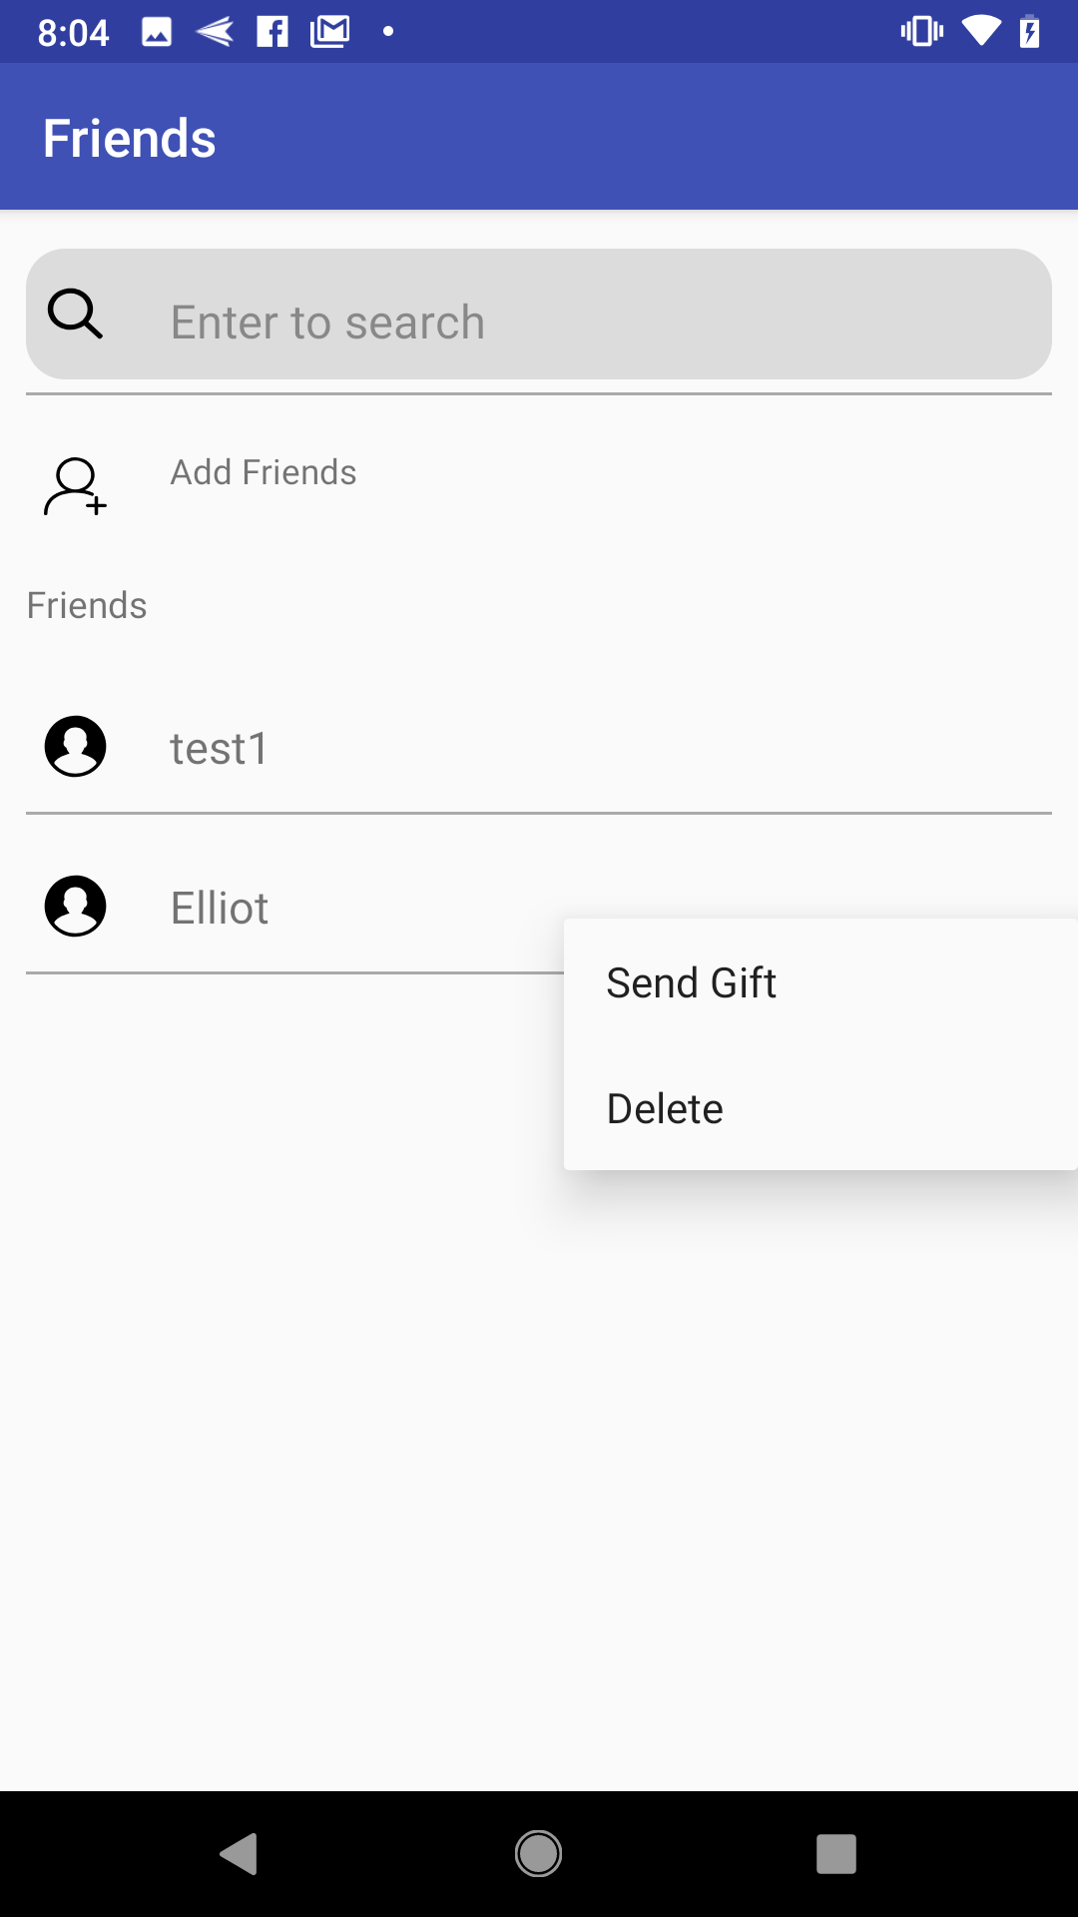
UI Design
Friends List Page

Slide 17
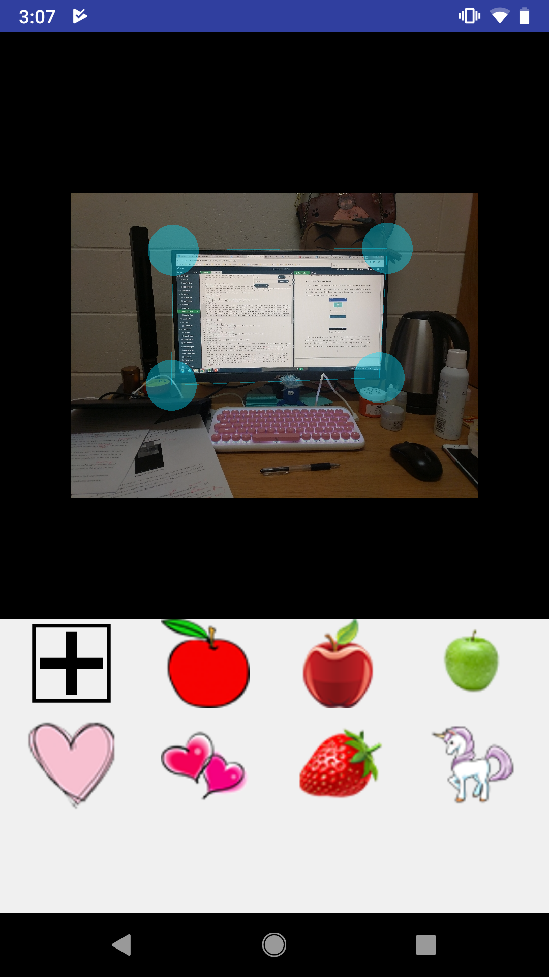
UI Design
Send Gift Page

Slide 18
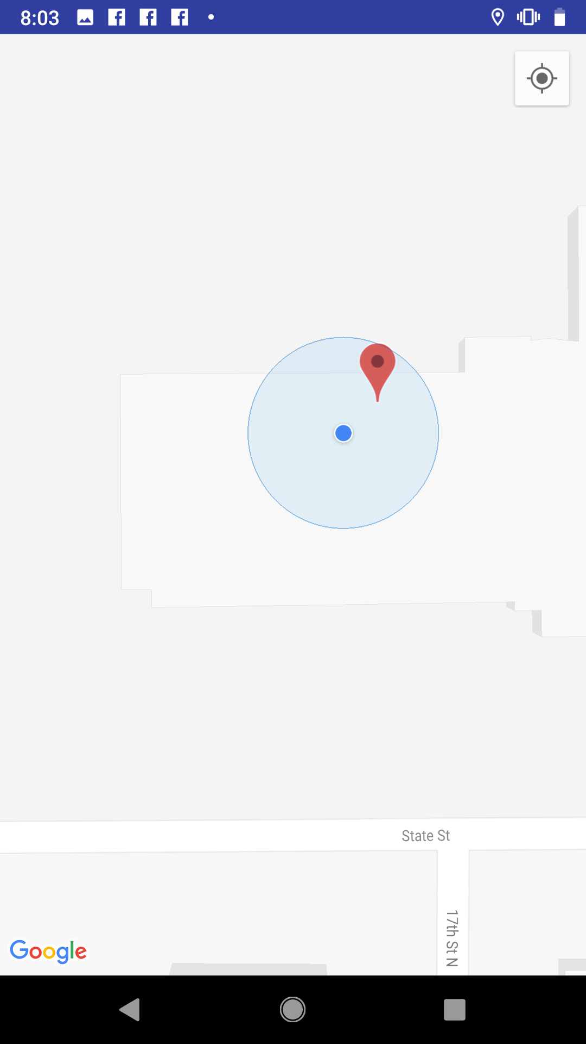
UI Design
Navigation Page

Slide 19
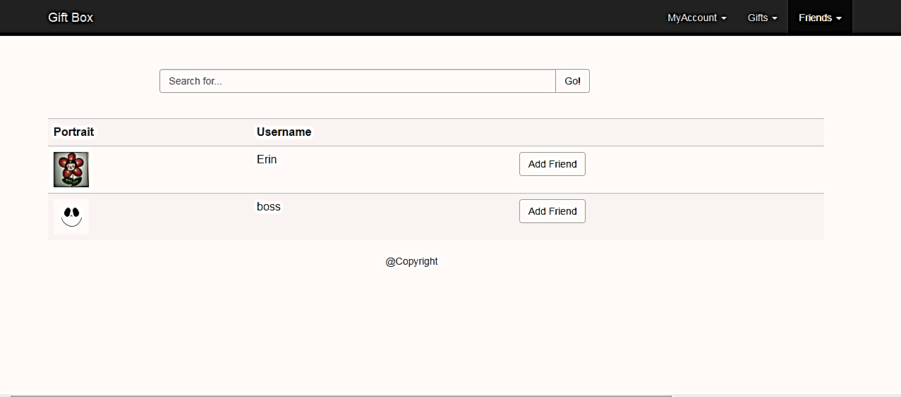
Ui design
View Friends Page

Slide 20
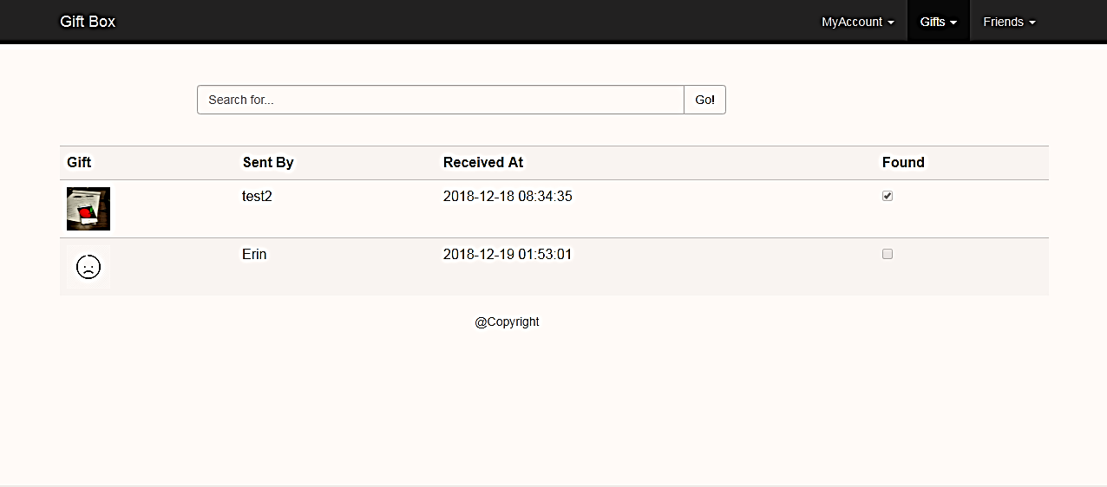
Ui design
View Gifts Page

Slide 21
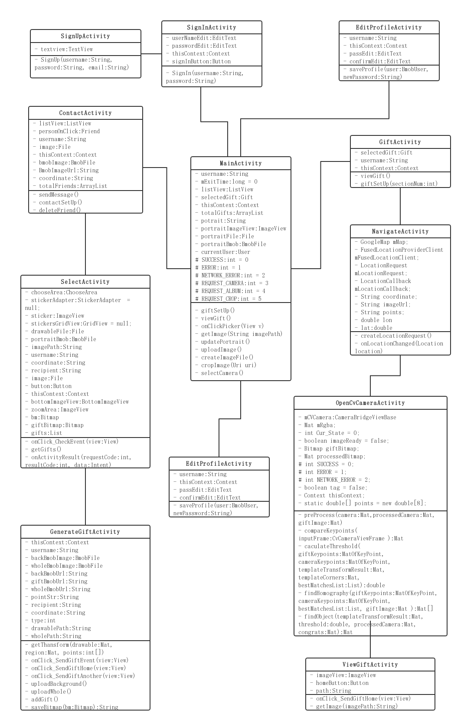
Android Class diagram
(continued)

Slide 22
Android Class diagram

Slide 23
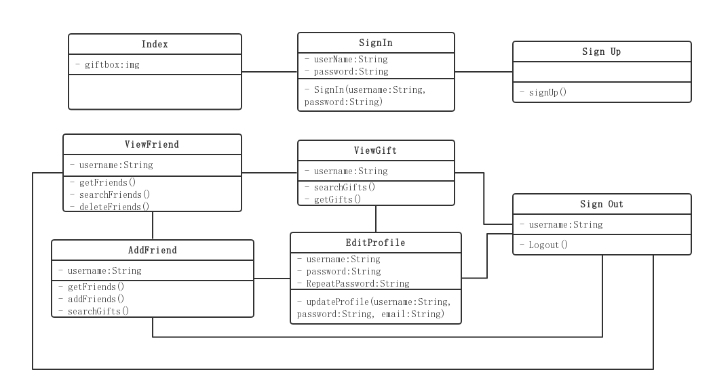
Web class diagram

Slide 24
implementation

Slide 25
development
Android
Get system permissions
Usage of AdapterView and Adapters
Call camera
Web Application
Bmob
Security concerns

Slide 26
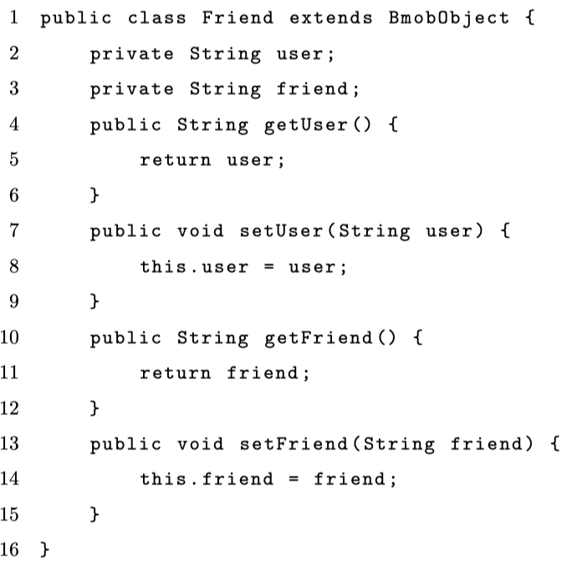
Bmob Usage
Friend Class

Slide 27
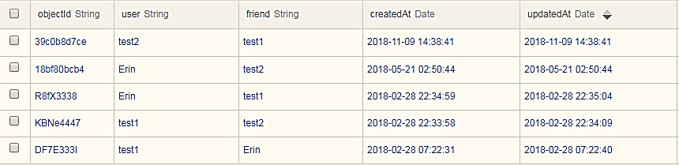
Friend table
‘Friend’ Table

Slide 28
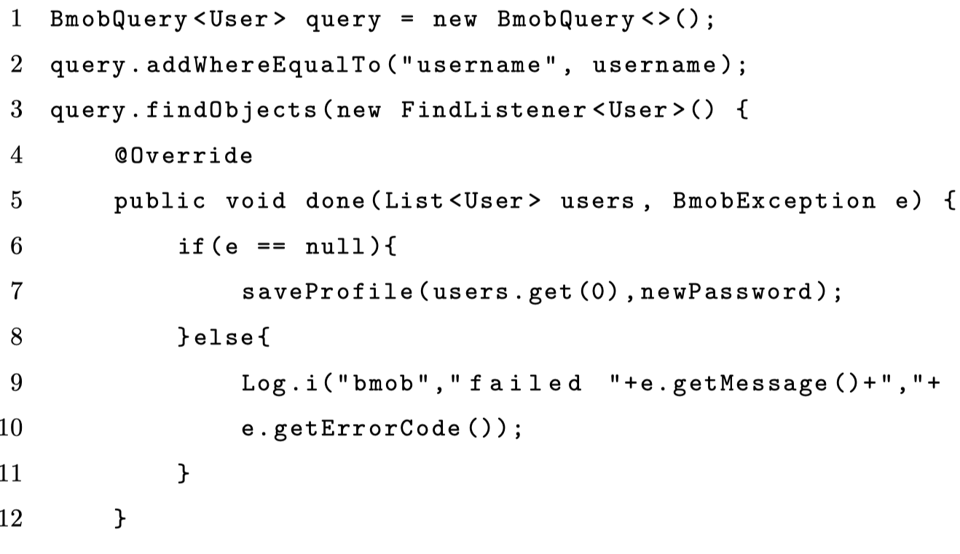
Database query
Bmob Query Template for Android Application

Slide 29
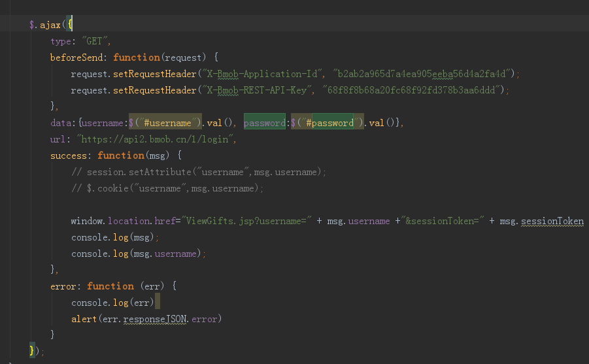
User Login
Bmob Login Template for Web Interface

Slide 30
Image Processing Algorithms with OpenCv

Slide 31
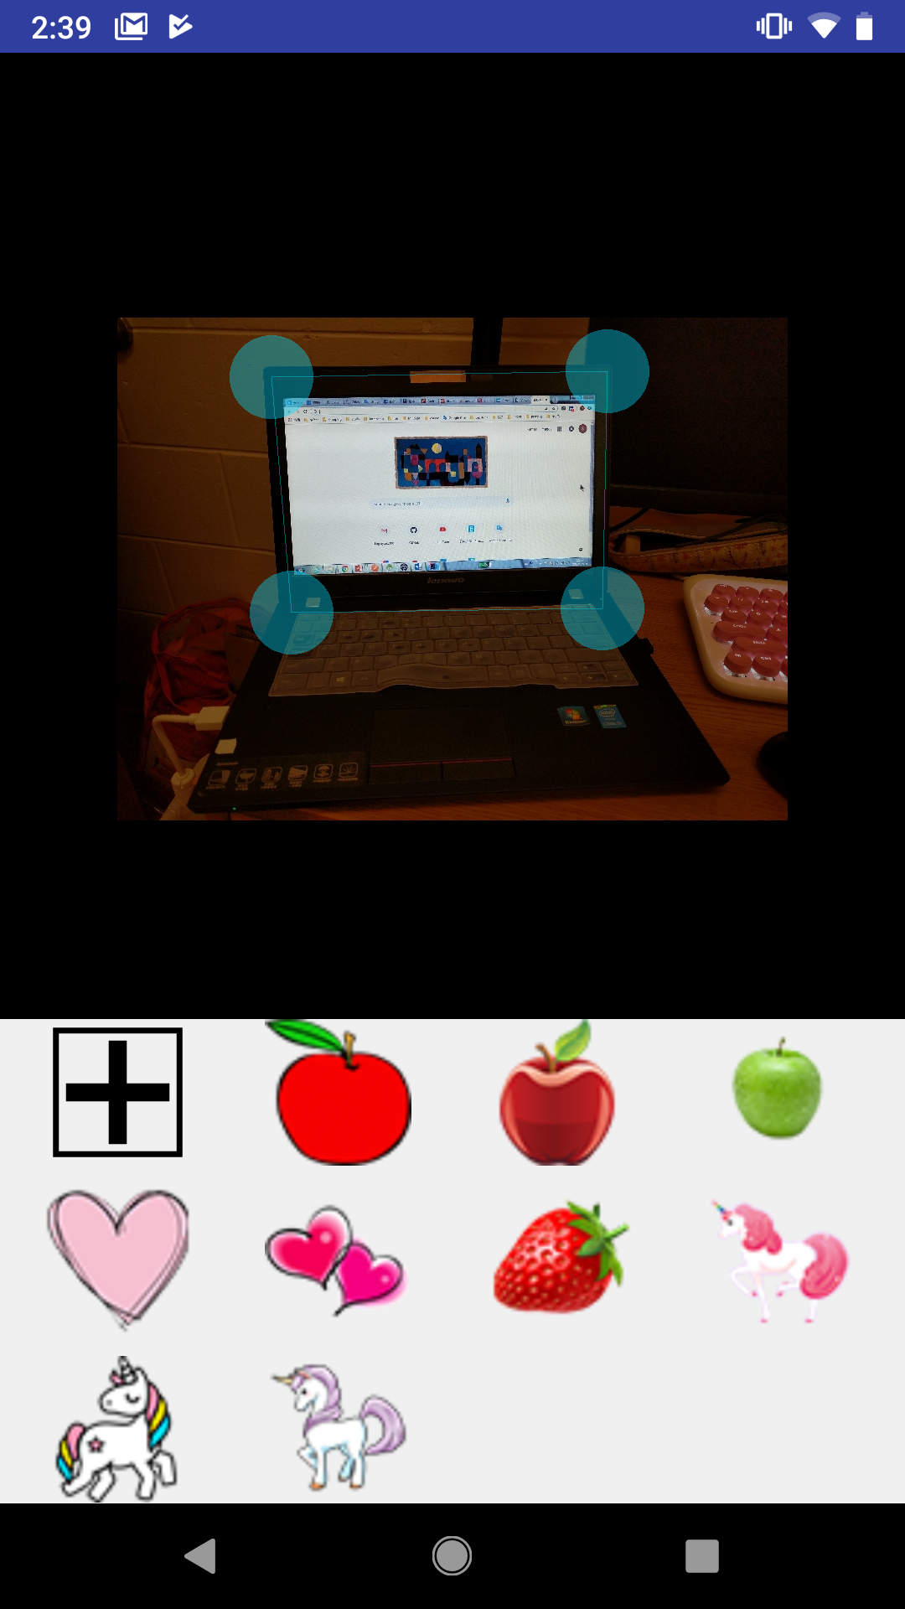
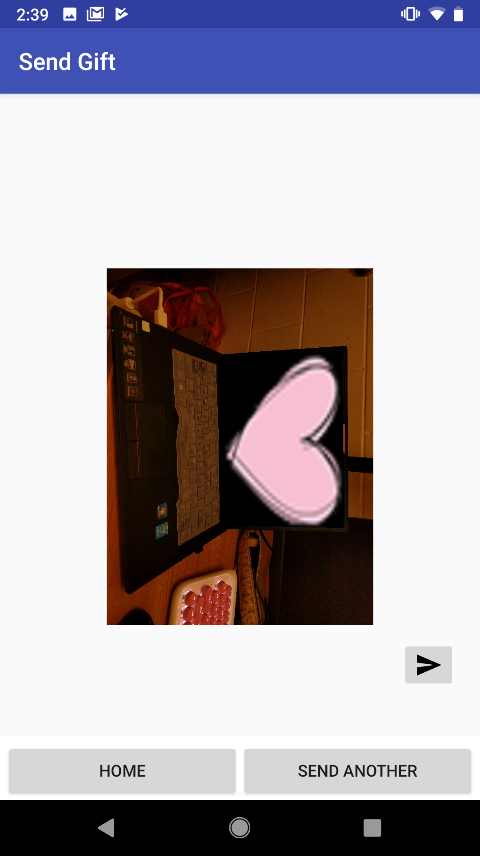

Gift transformation

Slide 32
Gift transformation
For perspective transformation, we use a 3x3 transformation matrix. To find this transformation matrix, we need four points on the gift image which will be the four corners of the gift image and corresponding points on the background image. The corresponding points will be the four corners of the user selected region. Among these four points, three of them should not be collinear. Then transformation matrix can be found by the function getPerspectiveTransform. Then use the warpPerspective function to apply transformation with this 3x3 transformation matrix.

Slide 33
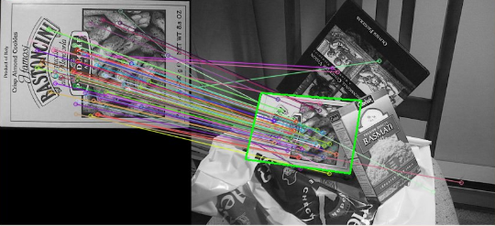
Region Recognition

Slide 34
Region Recognition
Detect the keypoints using ‘AKAZE’ detector
Calculate descriptors (feature vectors)
Matching descriptor using BRUTEFORCE_HAMMING matcher
Get the keypoints from the ‘good’ matches
Find a perspective transformation between two planes by using the findHomography method
Put the four corners from the selected region into the template matrix
Localize the object

Slide 35
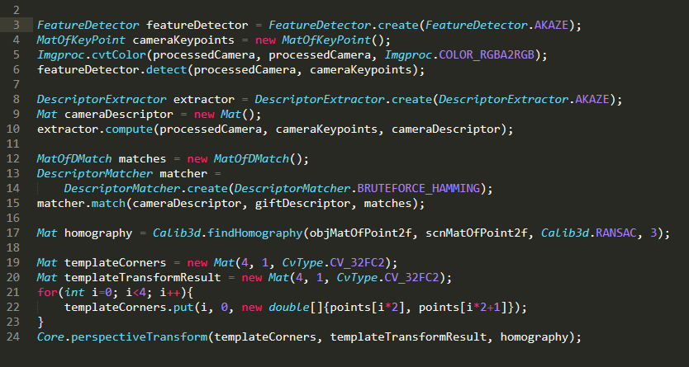
Region Recognition

Slide 36
Testing
The Android application had no formal unit testing, in large part due to the complex nature of image keypointing. Nonetheless, the system was heavily user tested and demonstrated reasonable performance
The web interface was mainly used to retrieve data and show it on the user interface. So we just test it by manual observation.

Slide 37
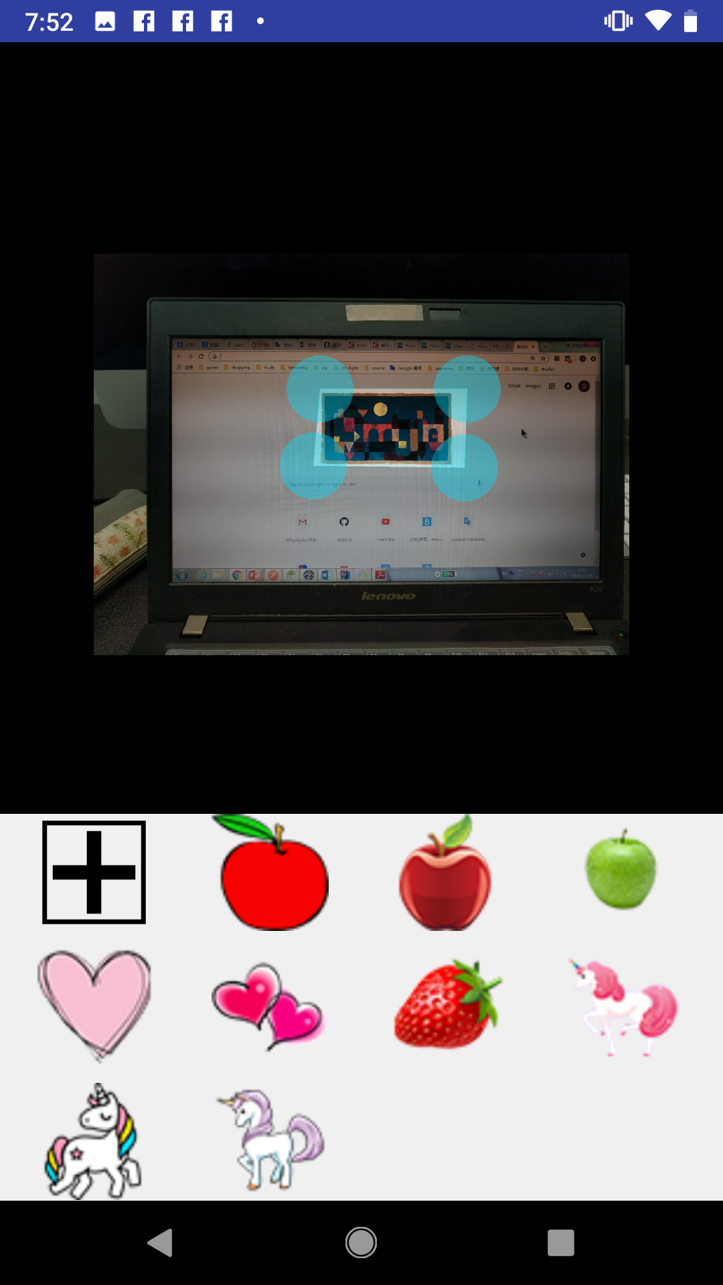
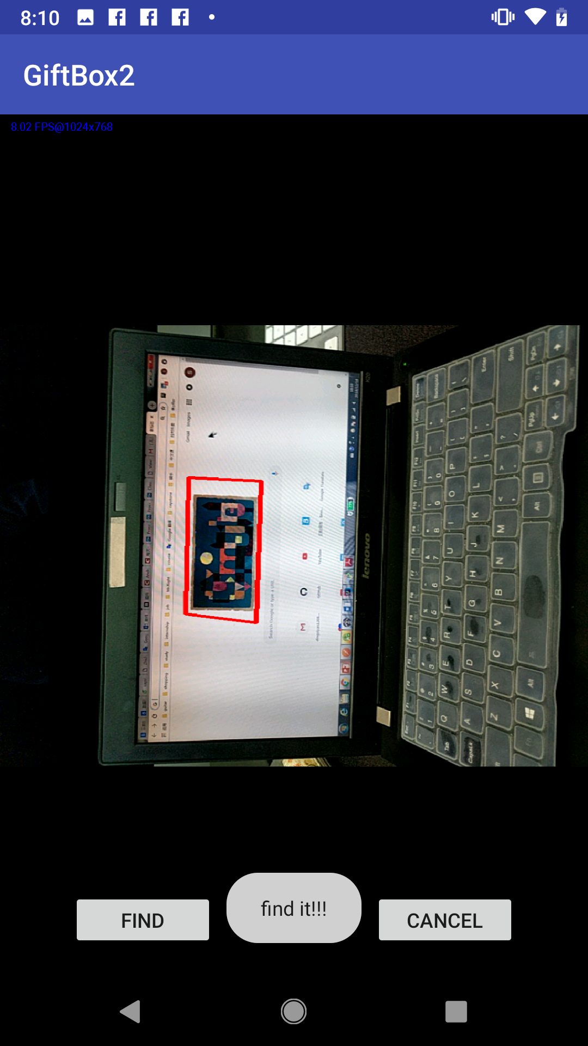
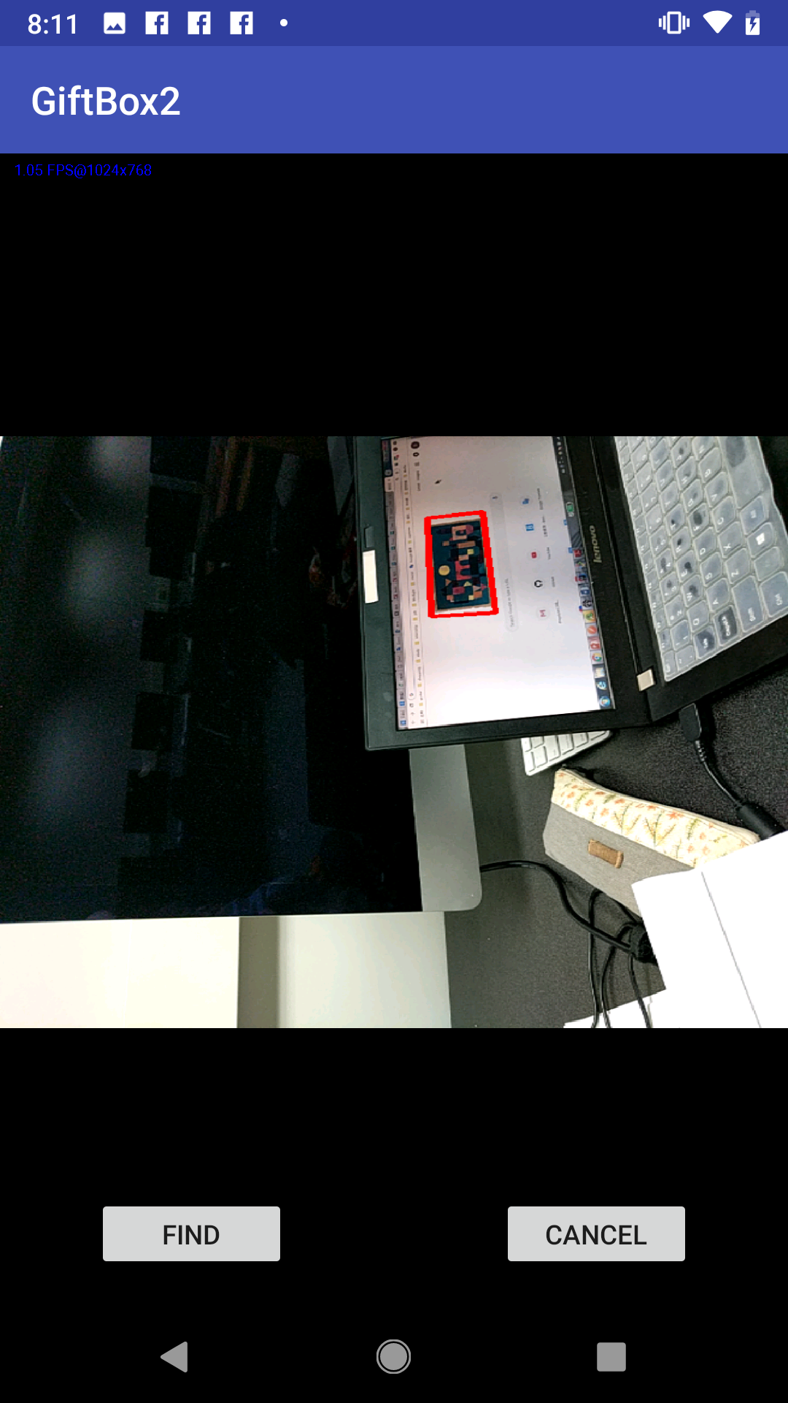
Recognition example(continued)

Slide 38
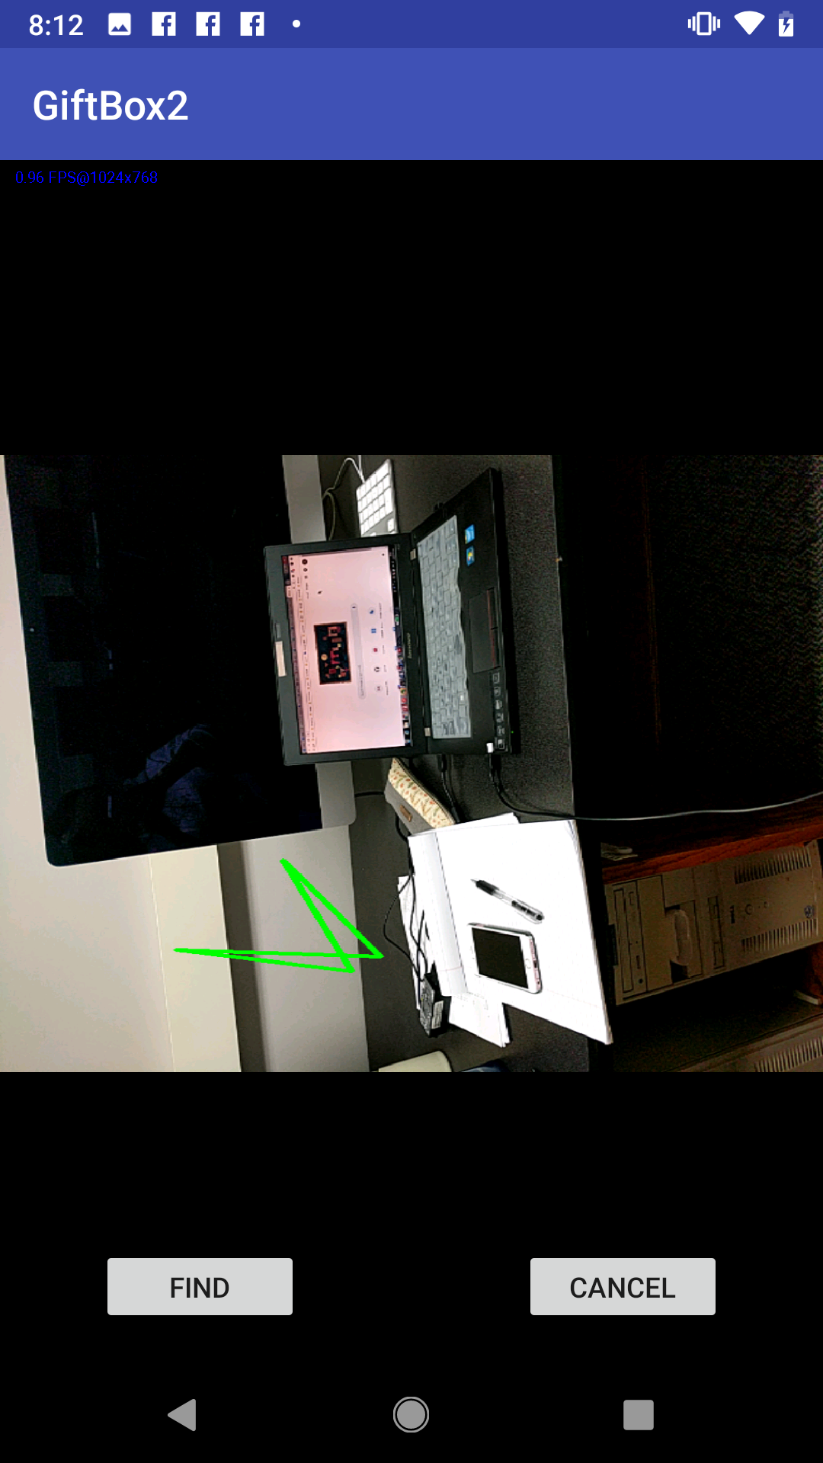
Recognition example

Slide 39
Conclusion
Basic social software functions like ‘add friends’, ‘delete friends’, ‘sign in’, ‘sign up’ and ‘edit proﬁle’ and we can also ’send gifts’ and ’ﬁnd gift’ using third-party recognition library suggested by Dr. Hunt
The Android application can navigate users to the gift location and detect user location in real time
We have 12 activities for the Android application and 8 pages for web interface.
More than three thousand lines of code has been generated

Slide 40
future work
The testing of accuracy of gift recognition needs to be completed, which requires thousands of actual scenes from diﬀerent places
User locations will support 3D
The image overlay (AR) will be finished
The user interface will be designed more attractively

Slide 41
DEMO

